Slide 1
ER to Relational schema

Slide 2
Conversion of ER diagram to Tables
Strong entity sets
Composite attributes
Multivalued attributes
Relationships sets
Weak entity sets

Slide 3
Components of conversion process
Three components of conversion process: –
Specify schema of relation itself
Specify primary key on the relation
Specify any foreign key references to other relations

Slide 4
Strong entity sets
Strong entity-set E with simple and single-valued attributes (a_1, a_2, … a_n)
Create a relational schema with same name E, and same attributes.
Primary key of relational schema is same as primary key of entity-set.
No foreign key references for strong entity-sets

Slide 5
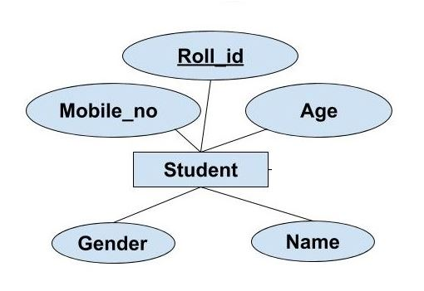
Strong entity sets to Table
Student Table
Roll_id | Name | Gender | Mobile_no | Age

Slide 6
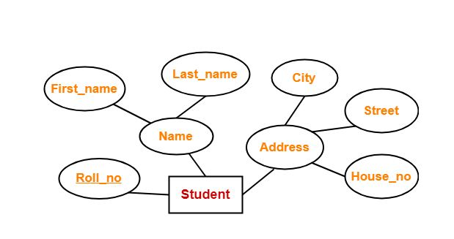
Composite attribute to Table
Student Table
Roll_no | First_name | Last_name | City | Street | House_no

Slide 7
Multivalued attribute
Separate table for each multivalued attribute
For multivalued attribute M in entity-set E
– Create a relation schema R to store M, with attribute A (single valued) corresponding to M
– Attributes of R are: A U primary_key ( E )
– Primary key of R includes all attributes of R
– Foreign key constraint from R to E, on primary_key ( E) attributes

Slide 8
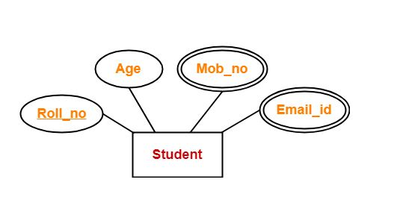
Multivalued attribute to Table
Rollno | AGE | MOB_NO | EMAILID
1 | 24 | 9877249515 | Abhay@gmail.com
1 | 24 | 7877249515 | NULL
WRONG SOLUTION RELATIONAL TABLE

Slide 9
SOLUTION 1
Rollno | AGE | MOB_NO_1 | MOB_NO_2 | MOB_NO_3 | EMAILID1 | EMAILID2
1 | 24 | 9877249515 | 8877249515 | 9877242215 | Abhay@gmail.com | Abhay@BENNETT.com
2 | 22 | 7877249515 | NULL | NULL | ROHAN@gmail.com | NULL
3 | 21 | 7877249512 | NULL | NULL | ROY@gmail.com | NULL
4 | 21 | 7877249511 | NULL | NULL | KRISHIV@gmail.com | NULL
5 | 21 | 7877249522 | NULL | NULL | NULL | NULL
FIND A STUDENT WHOSE MOB NO IS: 8877249515

Slide 10
SOLUTION 2
Rollno | AGE | MOB_NO_1 | EMAILID1
1 | 24 | 9877249515, 8877249515, 9877242215 | Abhay@gmail.com, Abhay@BENNETT.com
2 | 22 | 7877249515 | ROHAN@gmail.com
3 | 21 | 7877249512 | ROY@gmail.com
4 | 21 | 7877249511 | KRISHIV@gmail.com
5 | 21 | 7877249522 | NULL
SIMPLICITY IS LOST WHILE PERFORMING, DELETE,UPDATE AND SELECT

Slide 11
Multivalued attribute to Table
Student Table
Roll_no | Age
Mobile Table
Roll_no | Mob_no
Email Table
Roll_no | Email_id

Slide 12
Relationship set
Relationship-set R
Assume all participating entity-sets are strong entity sets
a_1, a_2, …, a_m is the union of all participating entitysets’ primary key attributes
b_1, b_2, …, b_n are descriptive attributes on R (if any)
Relational schema for R is:
{ a1, a 2, …, a m} U { b1, b 2, …, b n }
Primary key of R depends on R’s mapping cardinality

Slide 13
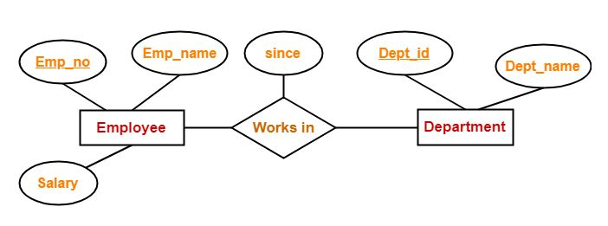
Relationship set
to Table
Works_in Table
Emp_no | Dept_id | since

Slide 14
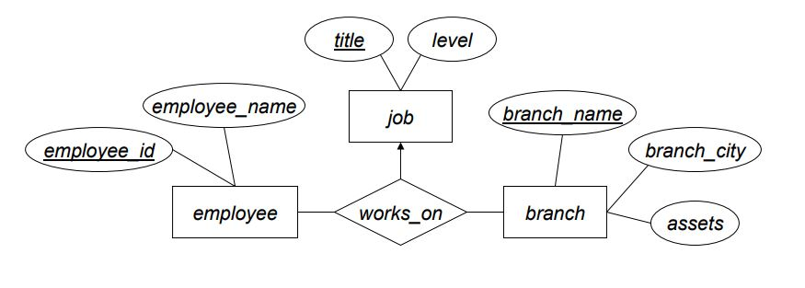
Task for students
Convert into relational schema

Slide 15
Solution
Entity-set schemas:
job (title, level )
employee (employee_id, employee_name )
branch (branch_name, branch_city, assets )
Relationship-set schema:
Primary key includes entity-sets on non-arrow links
works_on (employee_id, branch_name, title )

Slide 16
Binary relationship with cardinality ratio
Case-01: Binary relationship with cardinality ratio m:n
Case-02: Binary relationship with cardinality ratio n:1
Case-03: Binary relationship with cardinality ratio 1:n
Case-04: Binary relationship with cardinality ratio 1:1

Slide 17
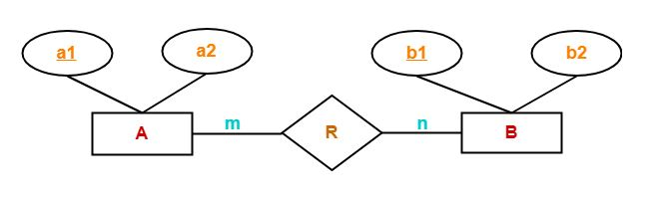
Case-01: Binary relationship with cardinality ratio m:n
Tables:
Table 1
A (a1, a2)
Table 2
B (b1, b2)
Table 3
R(a1, b1)

Slide 18
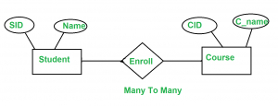
Example on cardinality ratio m:n
Student Table
Enroll Table
Courses Table
After minimization of Tables
SID | Name
S1 | Ram
S2 | David
S3 | Mohan
S4 | Shyam
S5 | John
SID | CID
S1 | C1
S2 | C1
S3 | C2
S1 | C2
S5 | C1
CID | C_name
C1 | DBMS
C2 | OS
Student (SID, Name)
Enroll (SID, CID)
Course (CID, C_name)

Slide 19
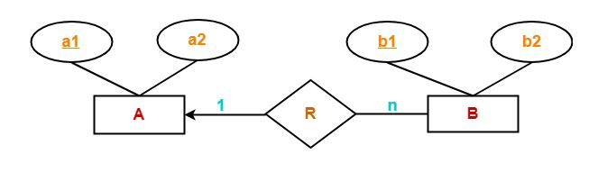
Case-02: Binary relationship with cardinality ratio 1:n
Tables:
Table 1
A (a1, a2)
Table 2
BR (a1, b1, b2)

Slide 20
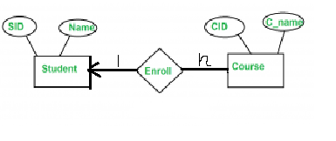
Example on cardinality ratio 1:n
Student Table
Enrolls Table
Courses Table
After minimization of Tables
SID | Name
S1 | Ram
S2 | David
S3 | Mohan
S4 | Shyam
S5 | John
SID | CID
S1 | C1
S2 | C3
S1 | C2
S2 | C4
S3 | C5
CID | C_name
C1 | DBMS
C2 | OS
C3 | DS
C4 | NS
C5 | IMS
Students (SID, Name)
Course_Enroll (CID, SID, C_name)

Slide 21
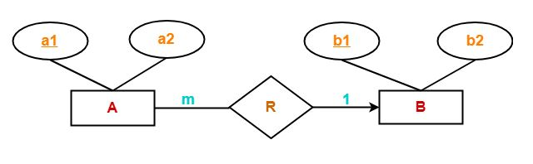
Case-03: Binary relationship with cardinality ratio m:1
Tables:
Table 1
AR (a1, b1, a2)
Table 2
B (b1, b2)

Slide 22

Example on cardinality ratio m:1
Student Table
Enroll Table
Course Table
After minimization of Tables
SID | Name
S1 | Ram
S2 | David
S3 | Mohan
S4 | Shyam
S5 | John
SID | CID
S1 | C1
S2 | C1
S3 | C2
S4 | C1
S5 | C2
CID | C_name
C1 | DBMS
C2 | OS
Student_Enroll (SID, CID, Name)
Course (CID, C_name)

Slide 23
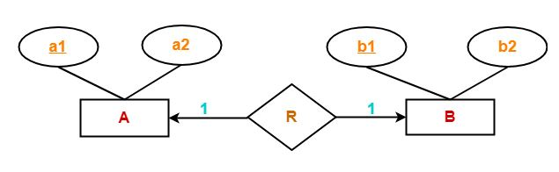
Case-04: Binary relationship with cardinality ratio 1:1
Tables:
Table 1
AR (a1, b1, a2)
Table 2
B (b1, b2)
Or
Table 1
A (a1, a2)
Table 2
BR (a1, b1, b2)

Slide 24
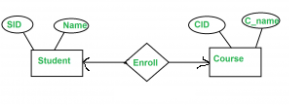
Example on cardinality ratio 1:1
Student Table
Enroll Table
Course Table
After minimization of Tables
SID | Name
S1 | Ram
S2 | David
S3 | Mohan
S4 | Shyam
S5 | John
SID | CID
S1 | C1
S2 | C3
S3 | C2
S4 | C5
S5 | C4
CID | C_name
C1 | DBMS
C2 | OS
C3 | DS
C4 | NS
C5 | IMS
Student_Enroll (SID, CID, Name)
Course (CID, C_name)
Or
Student (SID, Name)
Course_Enroll (CID, SID C_name)

Slide 25
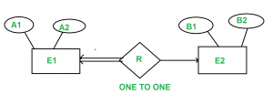
One to One relationship with total participation at one end
A1 and B1 are primary keys of E1 and E2 respectively.
Since E1 is in total participation, each entry in E1 is related to only one entry in E2, but not all entries in E2 are related to an entry in E1.
The primary key of E1 should be allowed as the primary key of the reduced table, since if the primary key of E2 is used, it might have null values for many of its entries in the reduced table.

Slide 26
Let's say you have two entities: Person and Passport.
One to One Relationship: Each person has exactly one passport, and each passport is issued to exactly one person.
Total Participation: Every person must have a passport.
Person_ID | Name | Address | Passport_Number | Issue_Date | Expiry_Date
1 | Alice | 123 Main St | P1234567 | 2022-01-01 | 2032-01-01
2 | Bob | 456 Elm St | P2345678 | 2023-05-12 | 2033-05-12
In this case, you could create a single table that includes the attributes of both the Person and the Passport.

Slide 27
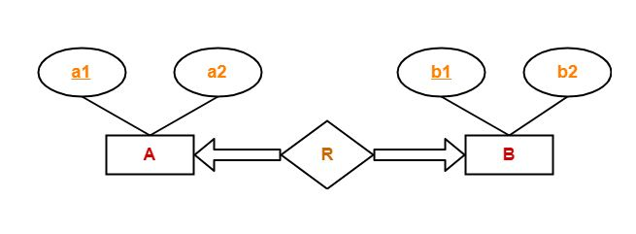
One to One relationship with total participation at both end
Only one table is required.
ARB ( a1 , a2 , b1 , b2 )

Slide 28
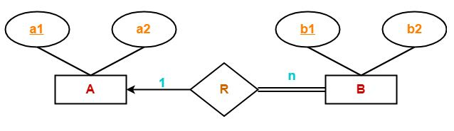
one to many relationship with total participation at many end
Here, two tables will be required-
A ( a1 , a2 )
BR ( b1 , b2, a1 )

Slide 29
Weak entity set
Weak entity-sets depend on at least one strong entity-set
Identifying entity-set, or owner entity-set
Relationship between the two called the identifying relationship
Weak entity-set A owned by strong entity-set B
Attributes of A are { a_1, a_2, …, a_m }
primary_key ( B) = { b_1, b_2, …, b_n }
Relational schema for A: { a_1,a_2,…, a_m} U { b1,b 2,…, b n }
Primary key of A is discriminator( A) U primary_key ( B )
A has foreign key constraint on primary_key ( B)

Slide 30
Identifying Relationship
Identifying relationship is many-to-one, with no descriptive attributes
Relational schema for weak entity-set includes primary key for strong entity-set
Foreign key constraint imposed, too
No need to create relational schema for identifying relationship.

Slide 31
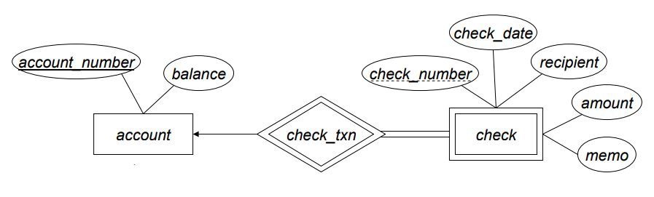
Weak entity set to table
account (account_number, balance)
check (account_number, check_number, check_data, recipient, amount, memo)

Slide 32
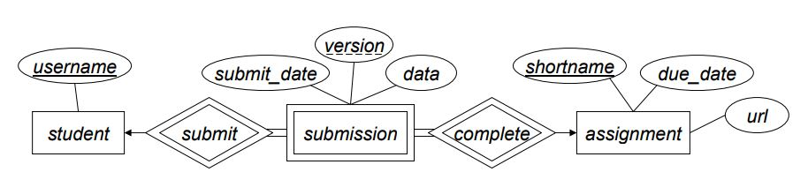
Weak entity set to table contd…
student (username)
assignment (shortname, due_date, url)
submission ( username, version, shortname, submit_date, data)

Slide 33
MCQ
What is the min and max number of tables required to convert an ER diagram with 2 entities and 1 relationship between them with partial participation constraints of both entities?
Min 1 and Max 2
Min 1 and Max 3
Min 2 and Max 3
Min 2 and Max 2

Slide 34
MCQ
What is the min and max number of tables required to convert an ER diagram with 2 entities and 1 relationship between them with partial participation constraints of both entities?
Min 1 and Max 2
Min 1 and Max 3
Min 2 and Max 3
Min 2 and Max 2

Slide 35
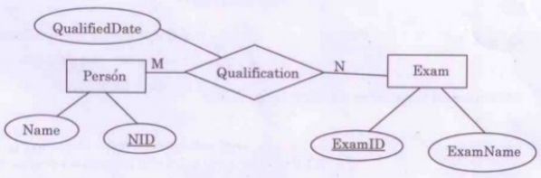
MCQ
Which of the following possible relations will not hold if the ERD is mapped into a relation model?
Person (NID, Name)
Qualification (NID, ExamID, QualifiedDate)
Exam (ExamID, NID, ExamName)

Slide 36
MCQ
Which of the following possible relations will not hold if the ERD is mapped into a relation model?
Person (NID, Name)
Qualification (NID, ExamID, QualifiedDate)
Exam (ExamID, NID, ExamName)

Slide 37
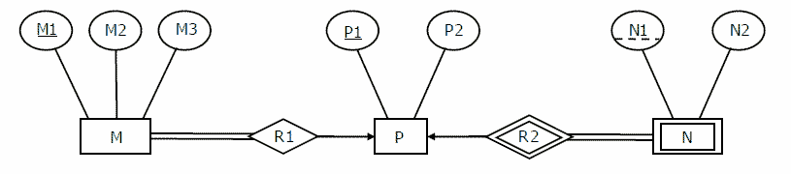
Over to You
Minimum number of tables needed to represent the entity relationship diagram is ___________.

Slide 38
Find the attribute sets of the minimized table.
Sol: M_R1 (M1,M2,M3,P1)
P (P1, P2)
N_R2 (P1, N1, N2)

Slide 39
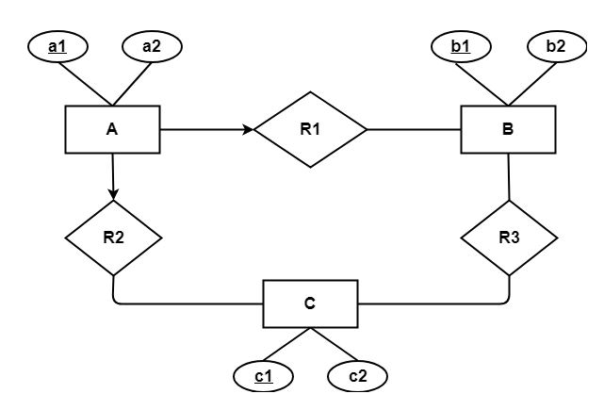
Find the minimum number of tables required to represent the given ER diagram in relational model

Slide 40
Solution
Applying the rules, minimum 4 tables will be required-
AR1R2 (a1 , a2 , b1 , c1)
B (b1 , b2)
C (c1 , c2)
R3 (b1 , c1)

Slide 41
https://www.gatevidyalay.com/er-diagrams-to-tables-practice-problems/
https://www.gatevidyalay.com/er-diagrams-to-tables-practice-problems/
http://homepages.inf.ed.ac.uk/libkin/teach/dbs14/ER-lecture.pdf
https://www.geeksforgeeks.org/mapping-from-er-model-to-relational-model/

